Slide 1
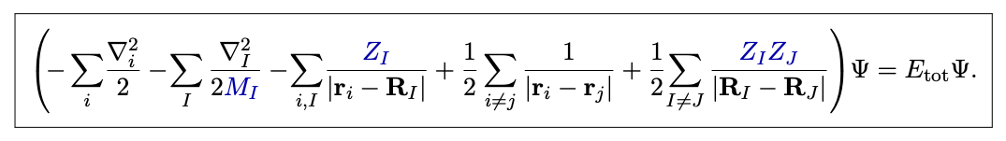

Physics Concerto
Computational Materials Physics
2025 Feb. 19th
(Almost) Everything is open source!
1
Feliciano Giustino, Materials Modeling using Density Functional Theory (2014)

Slide 2
+ FDTD + Phase Field Simulation
Physics Concerto
Computational Materials Physics
Density Functional Theory
2025 Feb. 19th
+ Machine Learning Force Field (MLFF)
+ Manybody Perturbation Theory
(Almost) Everything is open source!
1
Feliciano Giustino, Materials Modeling using Density Functional Theory (2014)

Slide 3

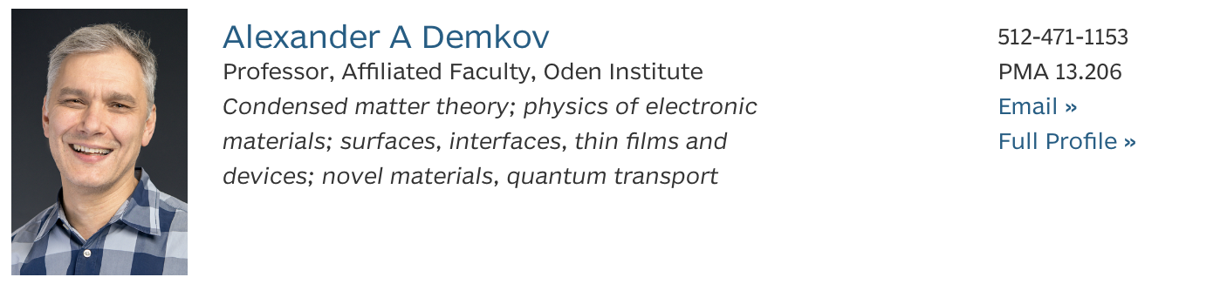

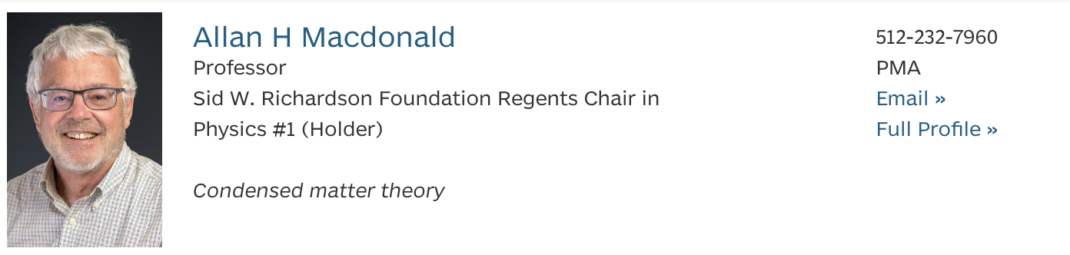
Last year

Slide 4

This year
One more by next Fall semester (half Physics/half Oden)

Slide 5
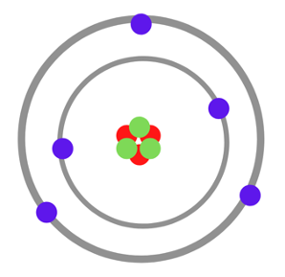
Atomic

Slide 6
Atomic

Slide 7
Bond angle
Valence electron
Bond length
Lattice vectors
Microscopic

Slide 8
Mesoscopic

Slide 9
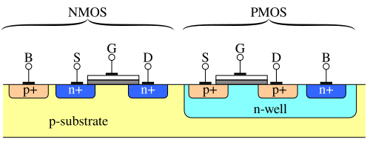
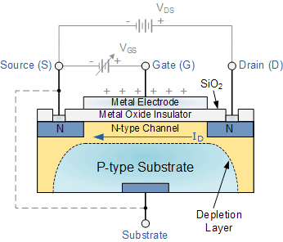
Electronics

Slide 10

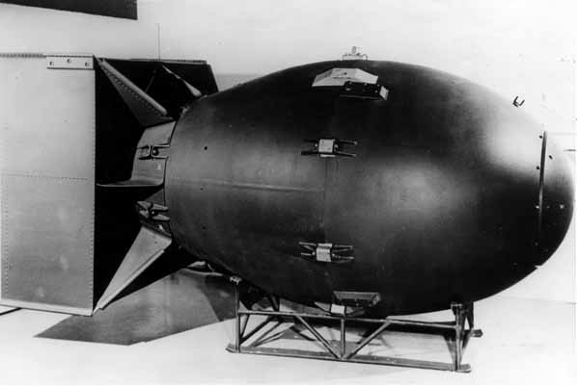

Computational Materials Physics
Thousands of Physicists
Billions of dollars
Bad for environment
What would you do first?
Some chemists
$5
Eco-friendly
2

Slide 11
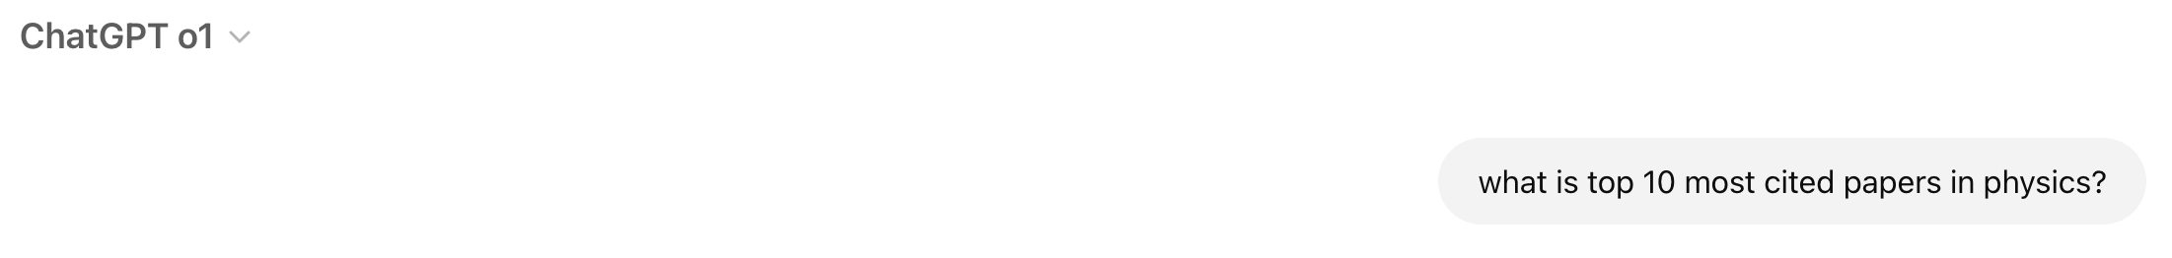
3

Slide 12
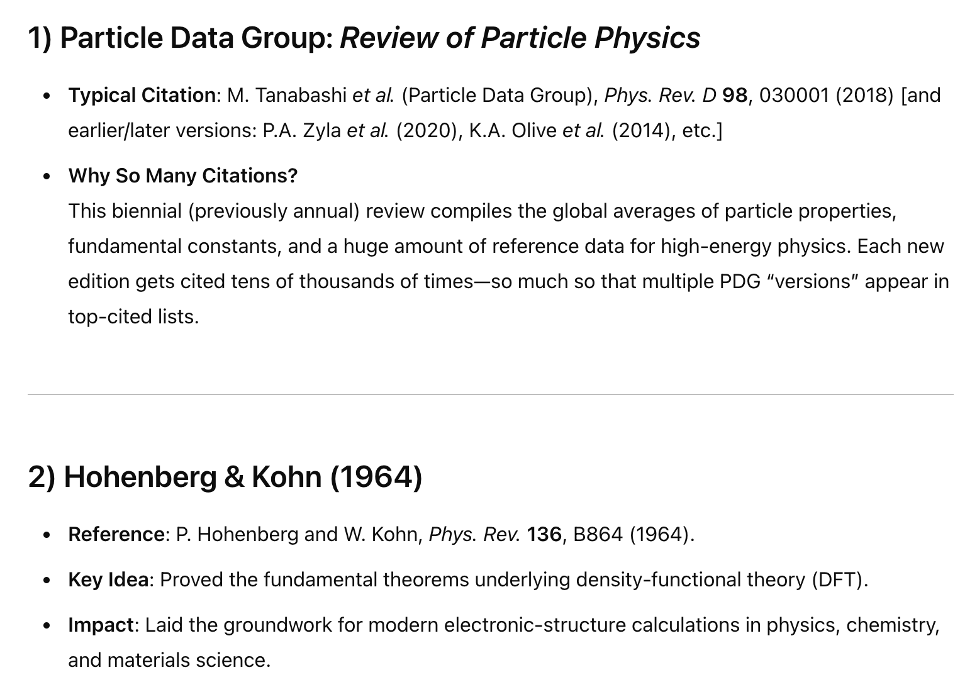
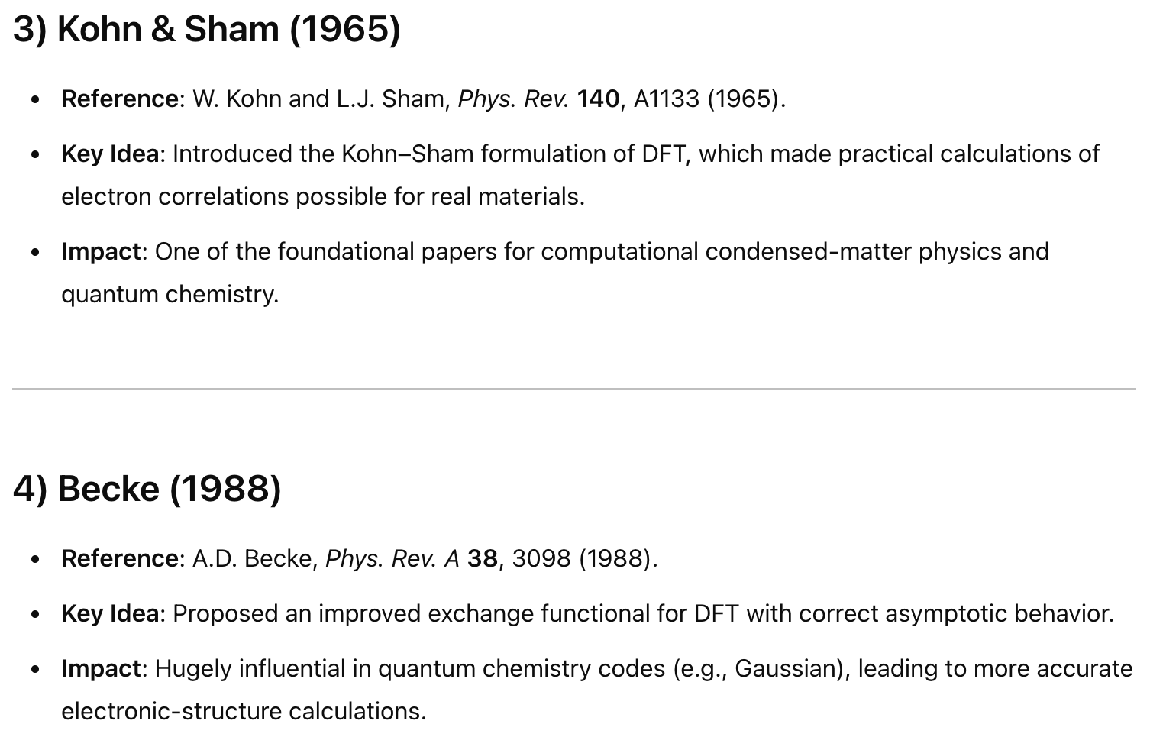
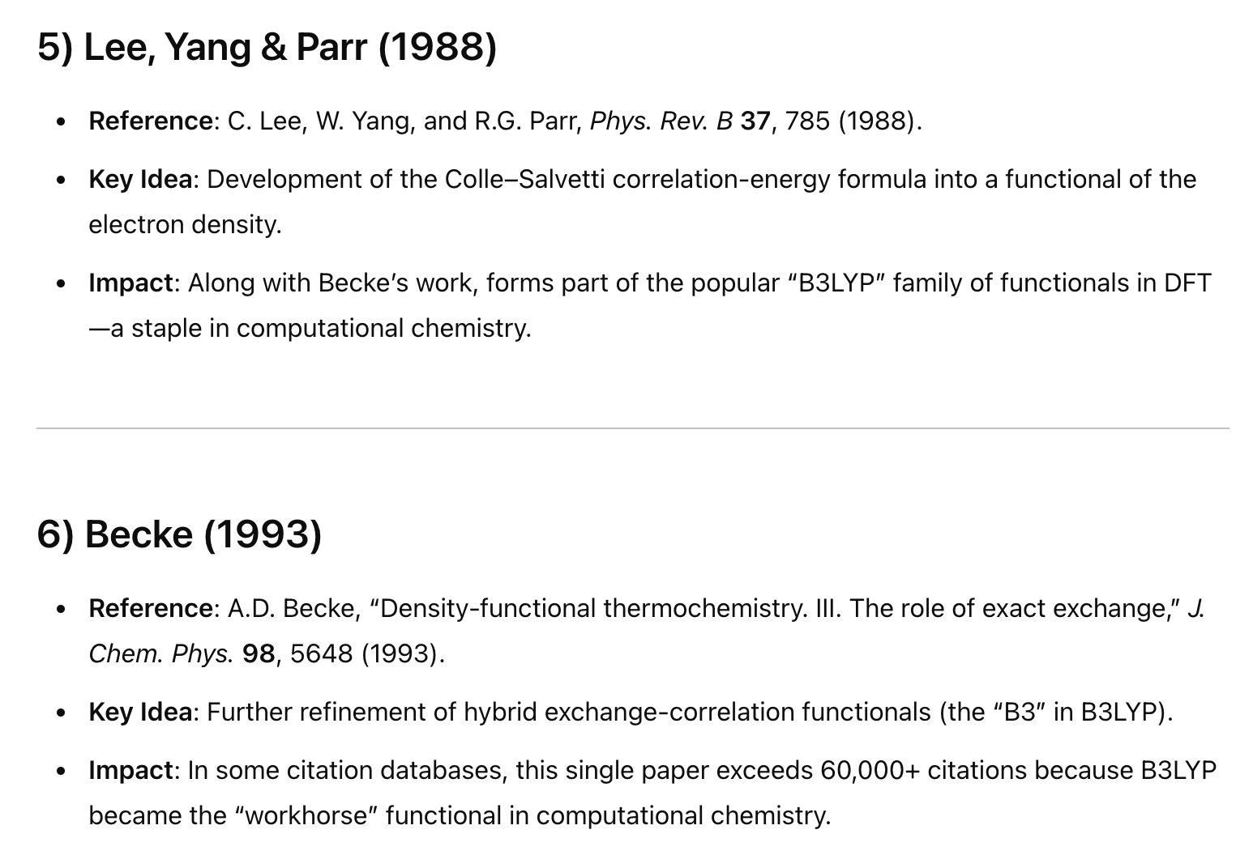
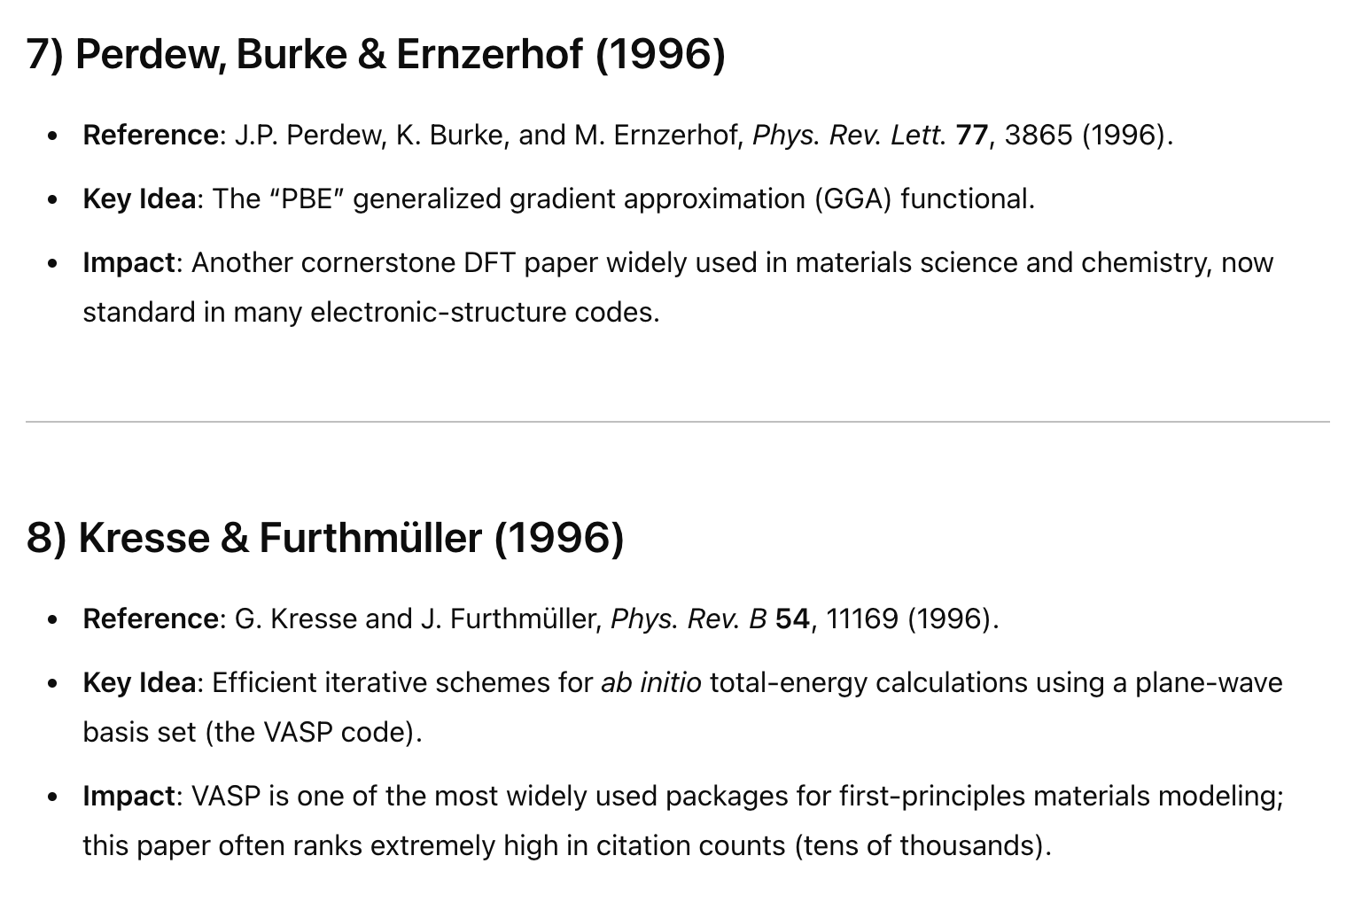
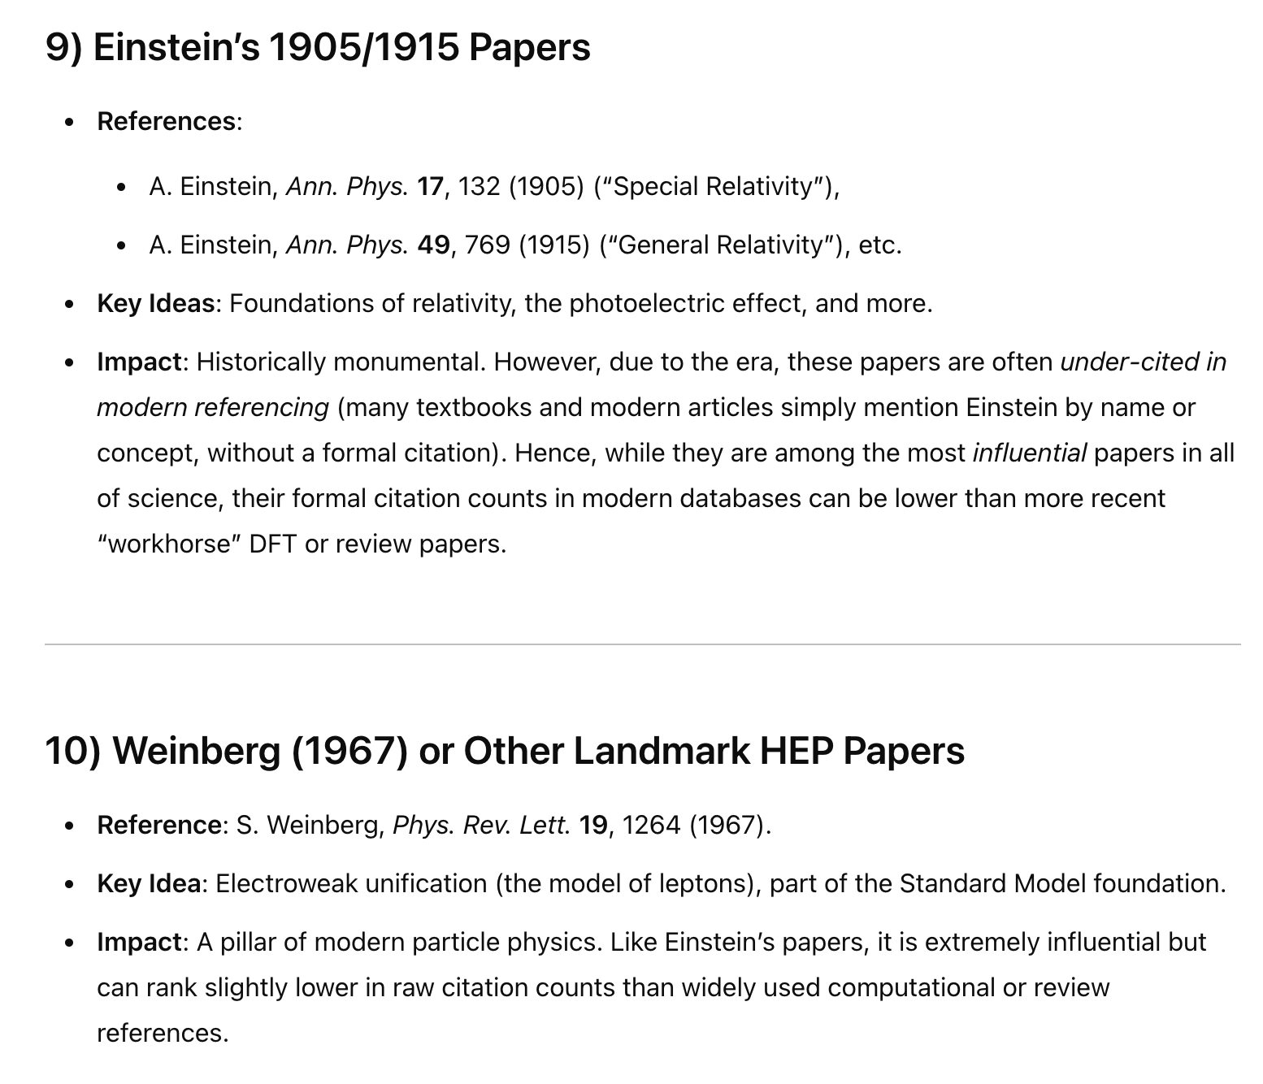
78,635
111,579
69,543
61,911
121,283
208,296
No data
114,798
20,473
4

Slide 13
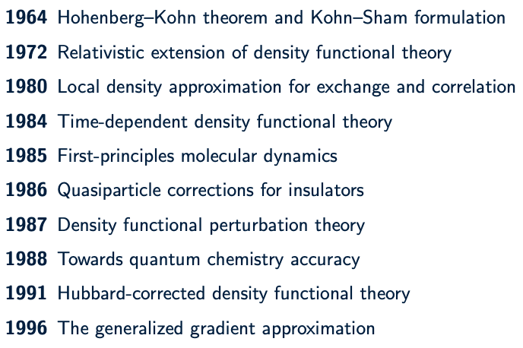
Density Functional Theory
5

Slide 14
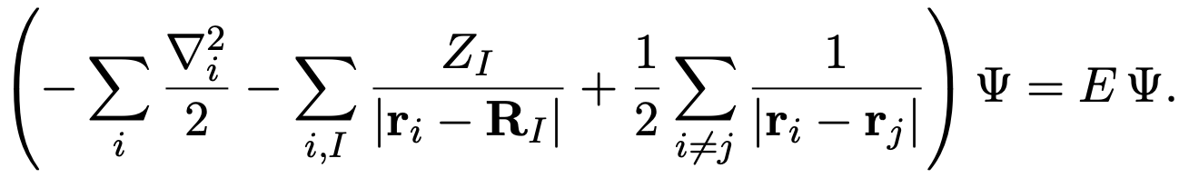
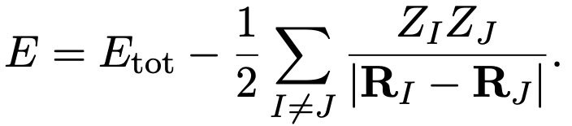
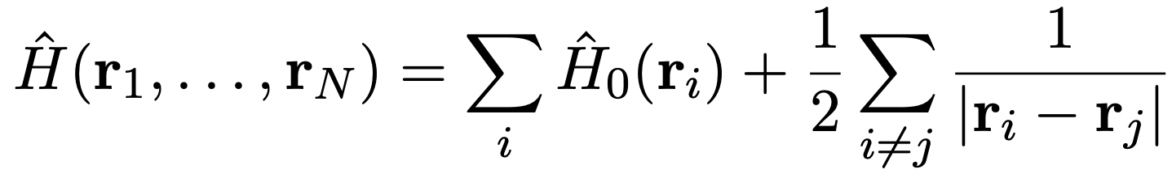
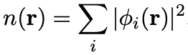
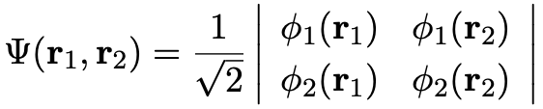
Density Functional Theory
You’ve never heard spin today… but works perfectly for a magnetic system as well.
Clamped nuclei
single-electron
many-electron
Independent electron approximation
Slater determinant
6

Slide 15
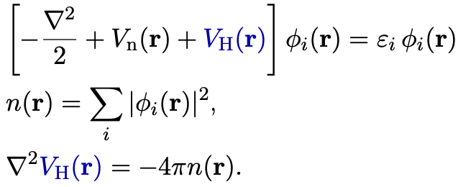
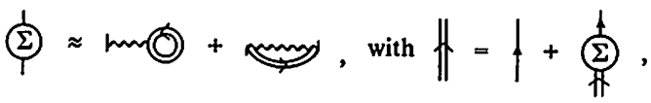
Density Functional Theory
single-electron
many-electron
Hartree or mean-field approximation
Self-consistent field method
7
Notes:
The computational detail is as follow. We mainly used ABINIT for our EO tensor calculation using DFPT, linear response, and 2n+1 theorem. For the phonon dispersion that we will show later, we used PHONOPY to calculate the harmonic approximation dynamical matrix.

Slide 16
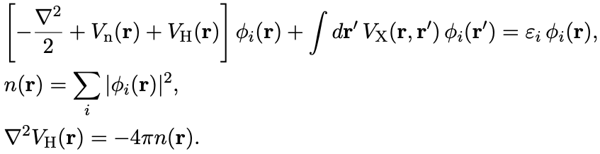
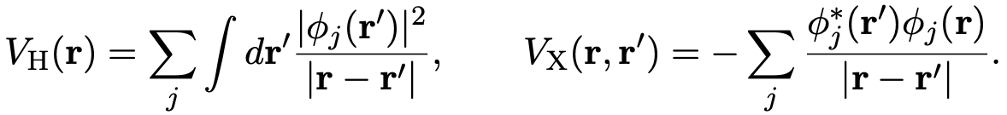
Density Functional Theory
single-electron
many-electron
Including exchange interaction
Self-interaction for localized orbitals
Nonlocal
8
Notes:
The computational detail is as follow. We mainly used ABINIT for our EO tensor calculation using DFPT, linear response, and 2n+1 theorem. For the phonon dispersion that we will show later, we used PHONOPY to calculate the harmonic approximation dynamical matrix.

Slide 17
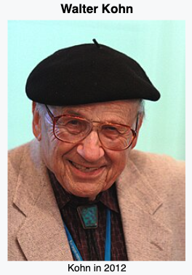
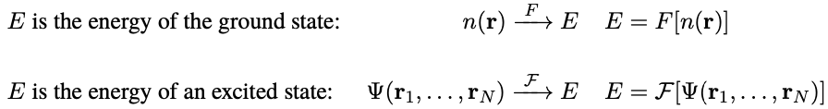
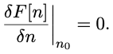
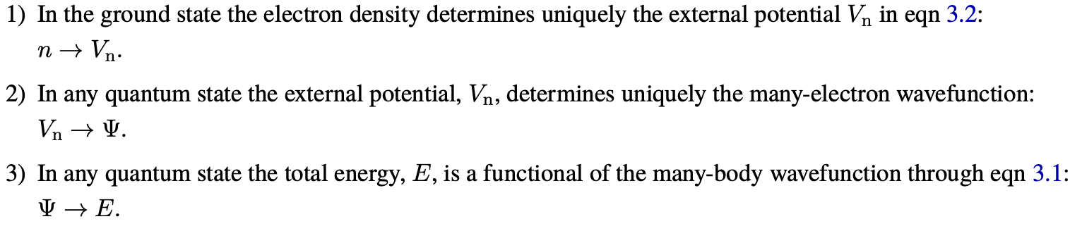
Density Functional Theory
Hohenberg-Kohn theorem
Nobel prize in Chemistry 1998
Schwinger’s student
The ground state energy of a many-electron system is expressed as a functional of the electron density!
Density Functional Theory!
9
Notes:
The computational detail is as follow. We mainly used ABINIT for our EO tensor calculation using DFPT, linear response, and 2n+1 theorem. For the phonon dispersion that we will show later, we used PHONOPY to calculate the harmonic approximation dynamical matrix.

Slide 18
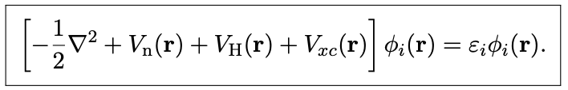
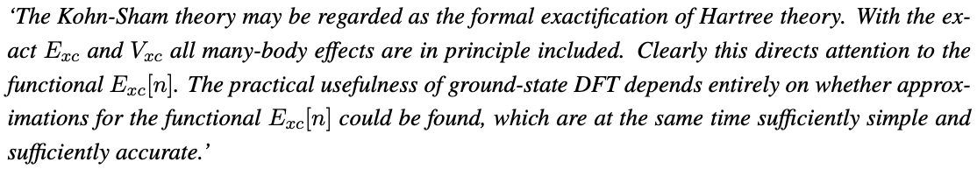
Density Functional Theory
Hohenberg-Kohn theorem
Kohn-Sham equation
Nothing but just Hartree potential…
10
Notes:
The computational detail is as follow. We mainly used ABINIT for our EO tensor calculation using DFPT, linear response, and 2n+1 theorem. For the phonon dispersion that we will show later, we used PHONOPY to calculate the harmonic approximation dynamical matrix.

Slide 19
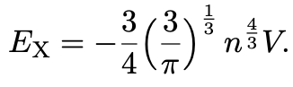
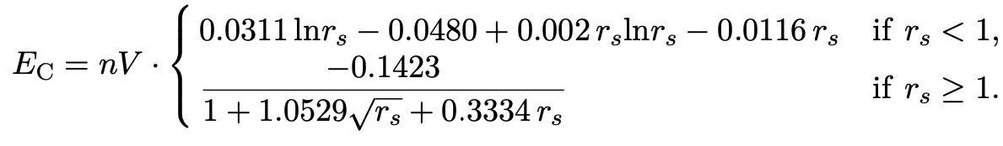
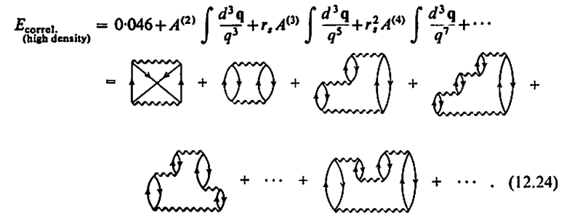
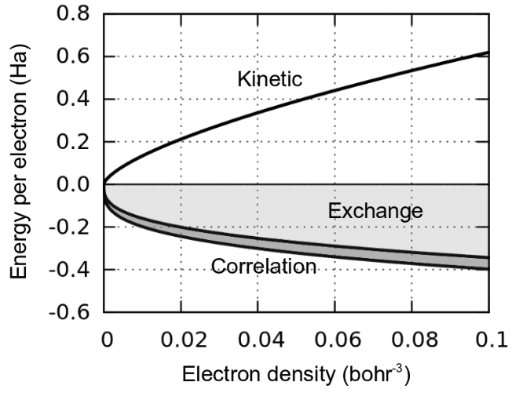
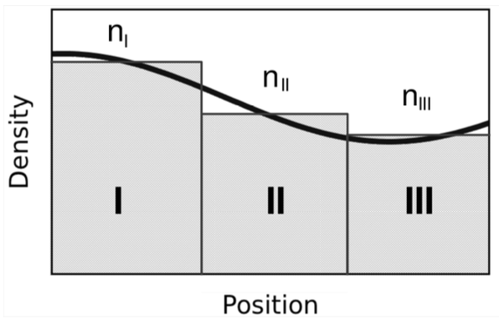
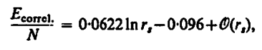
Density Functional Theory
But how can we determine exchange-correlation potential?
Assume homogeneous electron gas first
From Monte Carlo
First two terms are by Gell-Mann and Brueckner (1957)
11
Feliciano Giustino, Materials Modeling using Density Functional Theory (2014) Richard D. Mattuck, A Guide to Feynman Diagrams in the Many-Body Problem (1992)
Notes:
The computational detail is as follow. We mainly used ABINIT for our EO tensor calculation using DFPT, linear response, and 2n+1 theorem. For the phonon dispersion that we will show later, we used PHONOPY to calculate the harmonic approximation dynamical matrix.

Slide 20
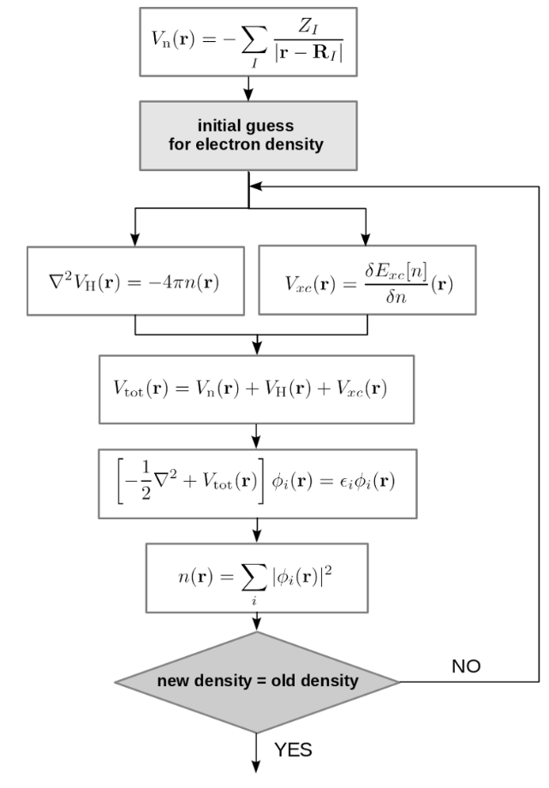
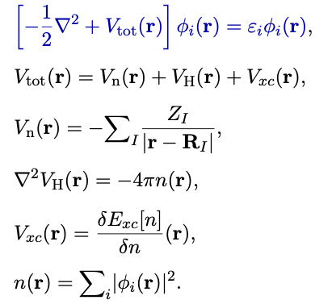
Density Functional Theory
Self-consistent calculation!
Energy, charge density
12
Notes:
The computational detail is as follow. We mainly used ABINIT for our EO tensor calculation using DFPT, linear response, and 2n+1 theorem. For the phonon dispersion that we will show later, we used PHONOPY to calculate the harmonic approximation dynamical matrix.

Slide 21
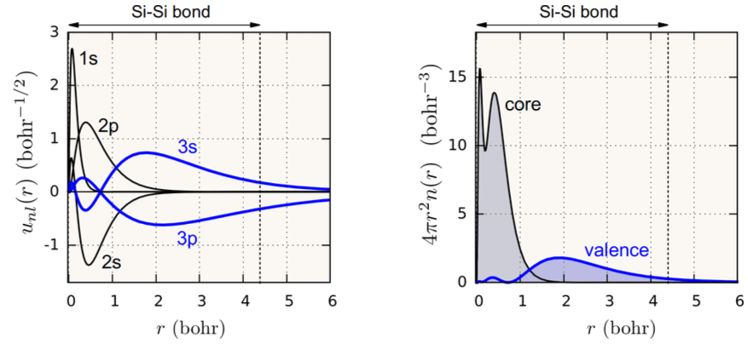
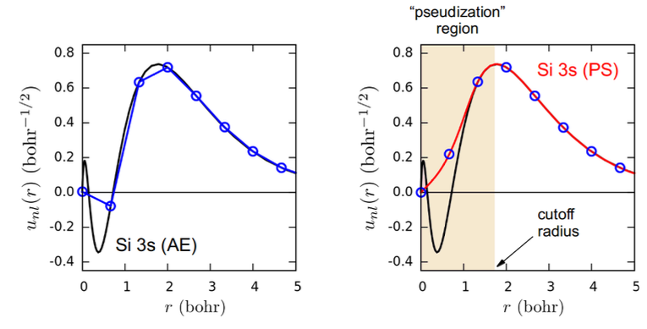
Pseudopotential
Norm-conserved Pseudopotential
Ultrasoft Pseudopotential
Projector Augmented Wave
13

Slide 22
Taylor Expansion of the Total Energy
Forces
Polarization
Stress
Harmonic force constants
Dielectric susceptibility
Elastic moduli
Born-effective charges
Force response of the internal strain tensor
Piezoelectric strain tensor
Nonlinear susceptibility
Raman susceptibility matrix elements
Elasto-optic tensor
Super important to decide materials properties!!!
14
Wu, Vanderbilt, and Hamann, Systematic treatment of displacements, strains, and electric fields in density-functional perturbation theory, Physical Review B 72, 035105 (2005)

Slide 23
Taylor Expansion of the Total Energy
Finite difference method
Hellmann-Feynman
Modern Theory of Polarization
Stress Theorem
DFPT
DFPT Finite electric field
DFPT
DFPT Finite electric field
DFPT
DFPT Finite electric field
2n+1 theorem Finite electric field
2n+1 theorem Finite electric field
2n+1 theorem Finite electric field
15
Wu, Vanderbilt, and Hamann, Systematic treatment of displacements, strains, and electric fields in density-functional perturbation theory, Physical Review B 72, 035105 (2005)

Slide 24
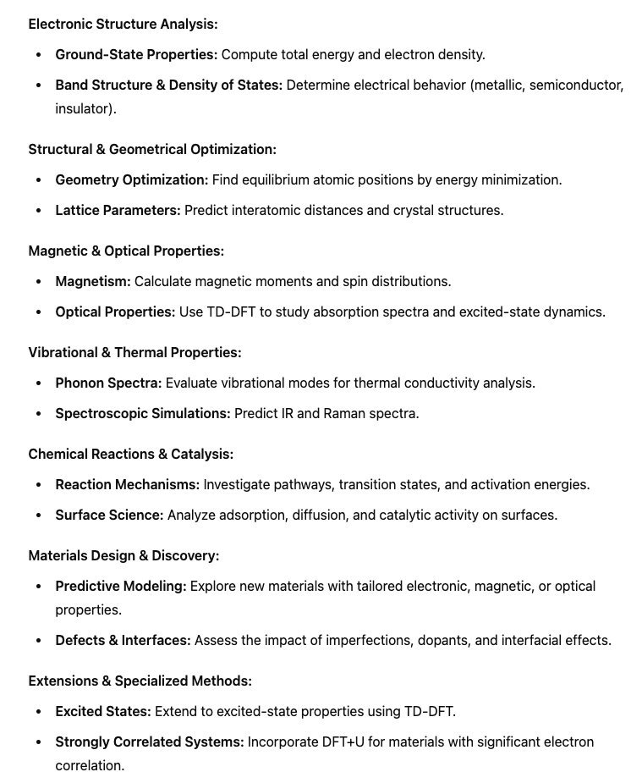
What can you do with DFT?

Slide 25
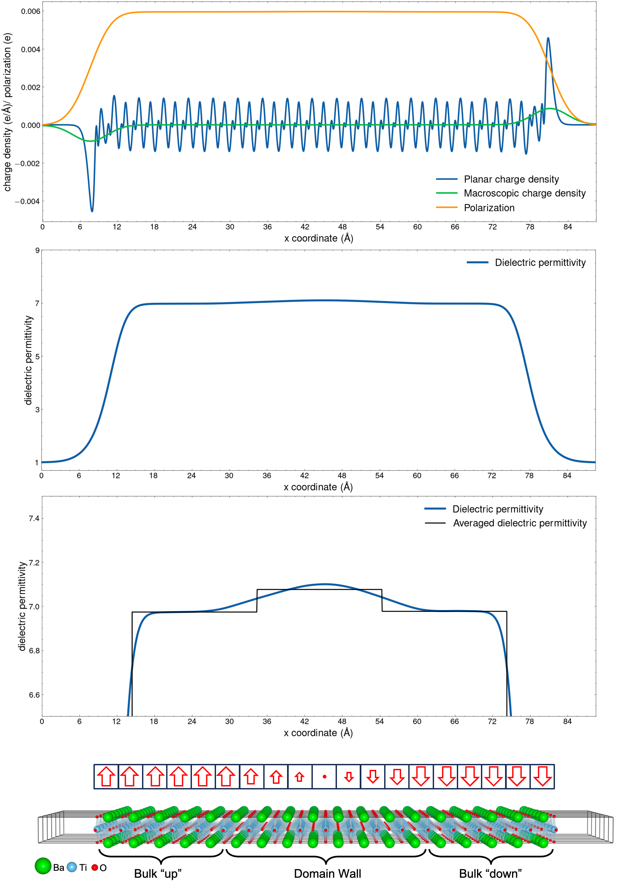
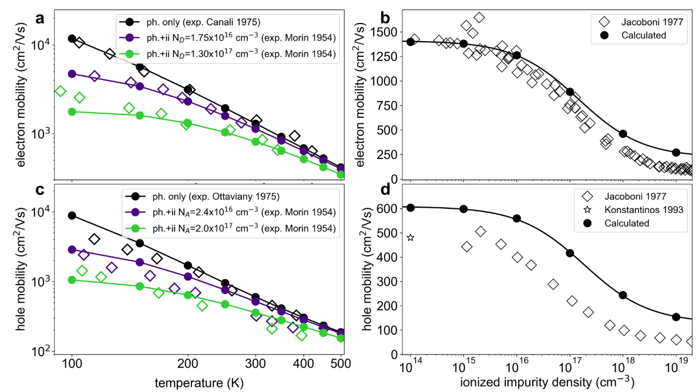
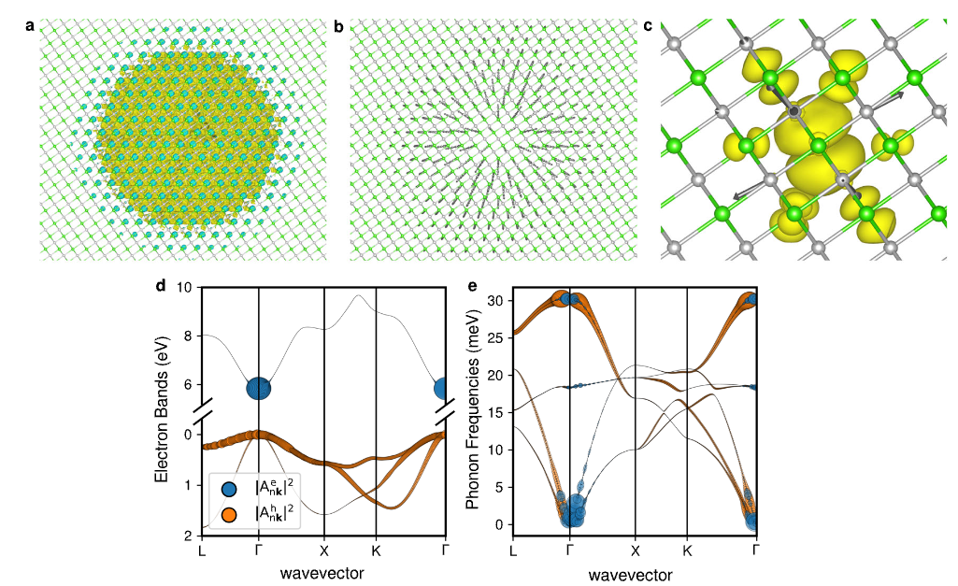
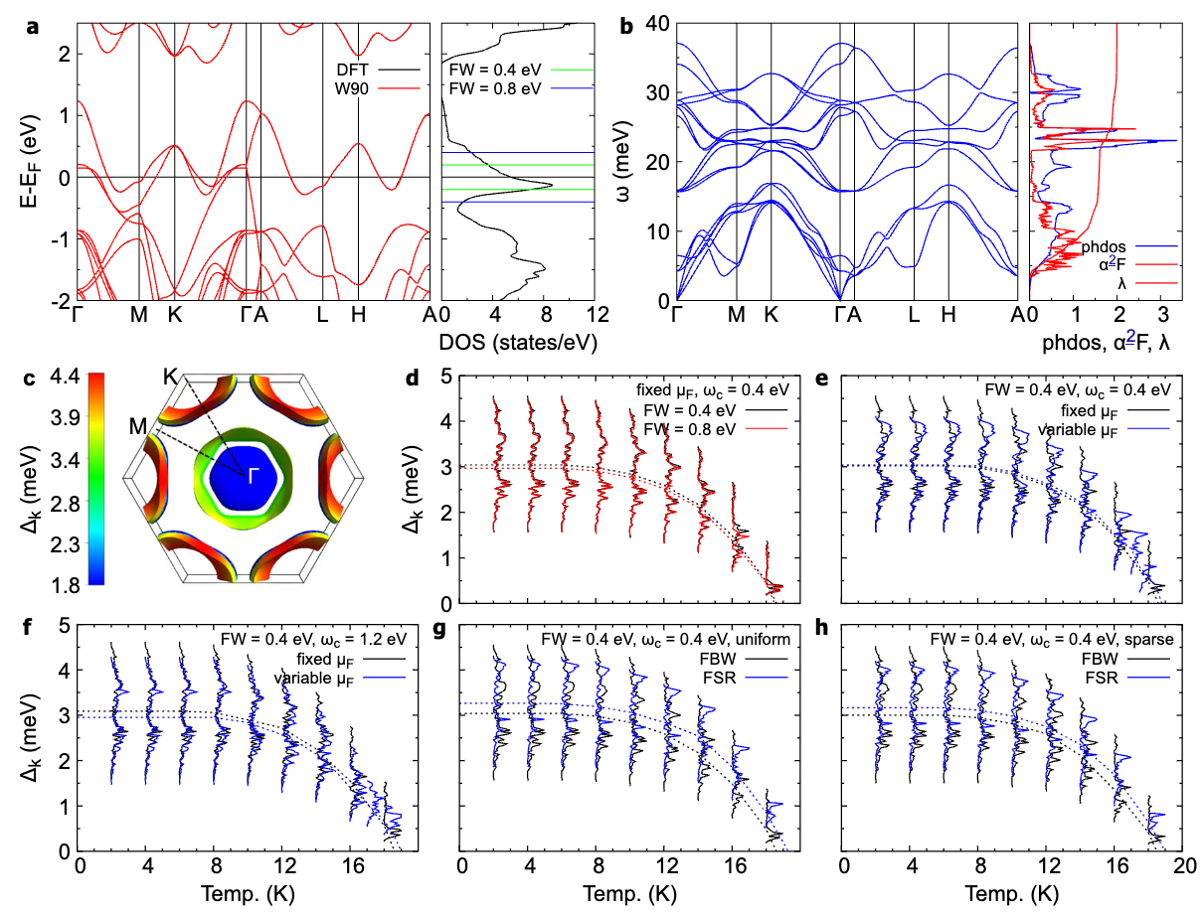
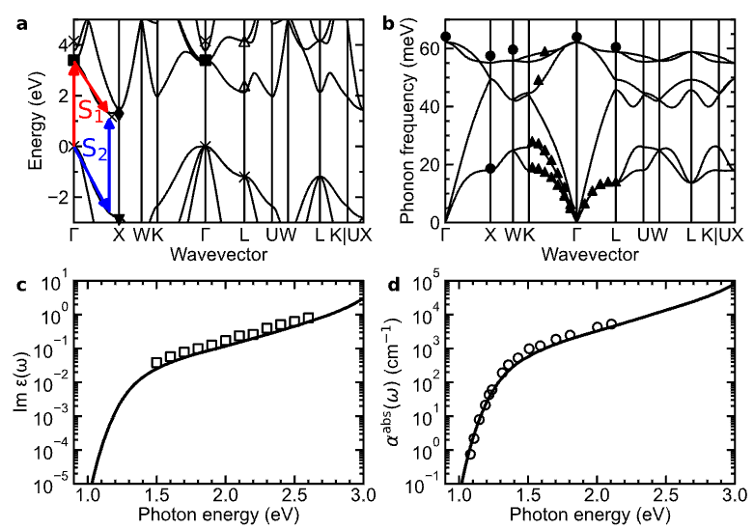
What can you do with DFT?

Slide 26
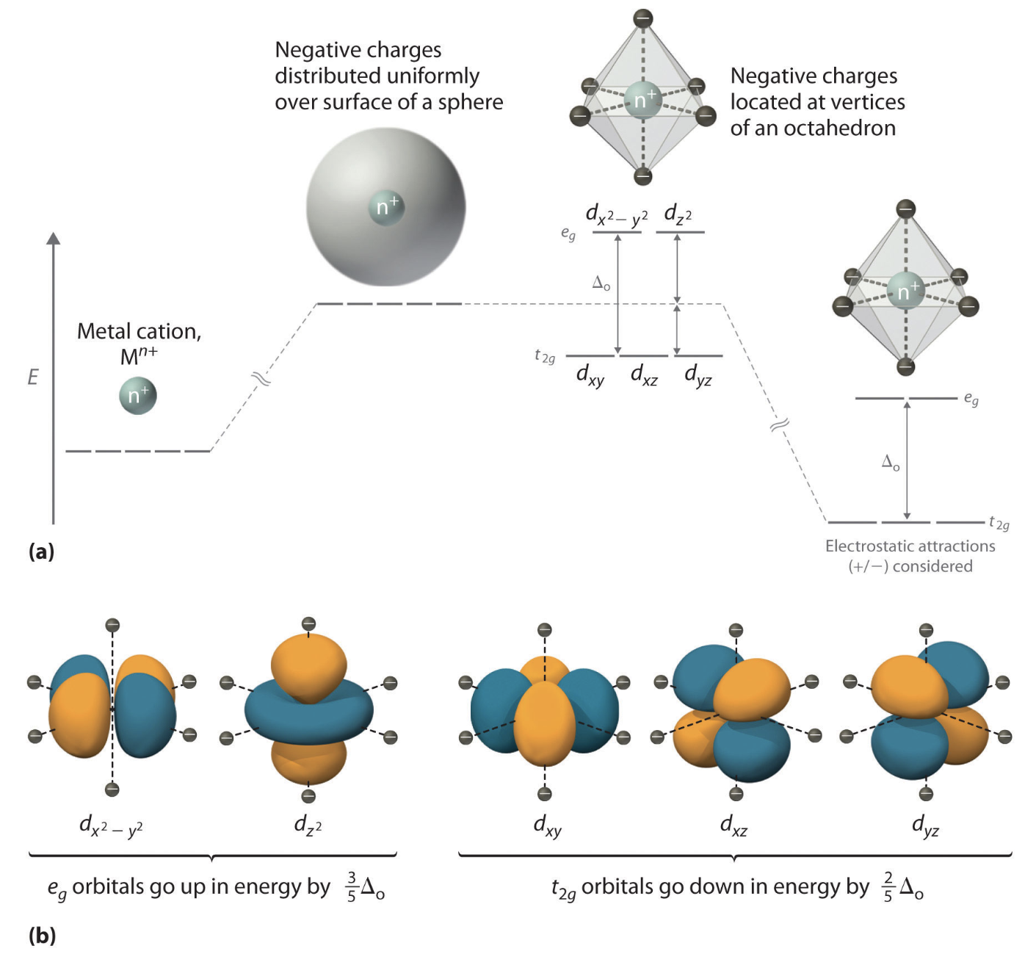
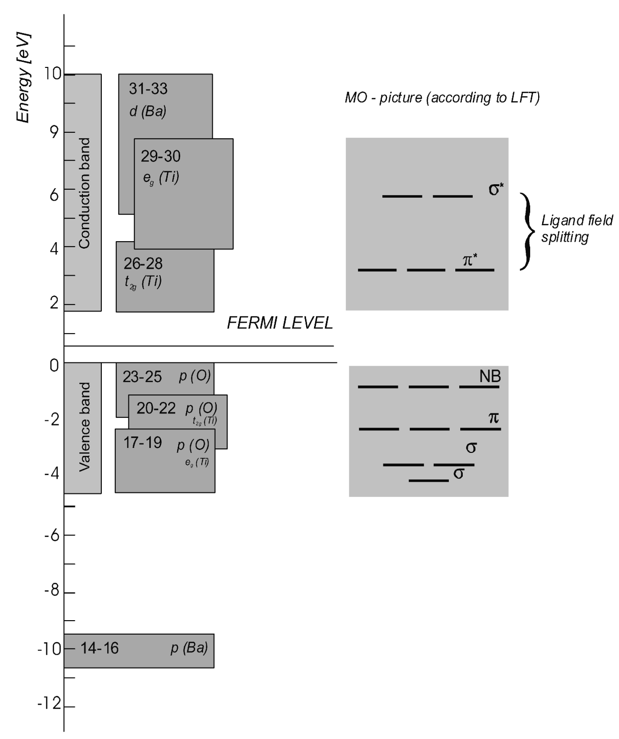
Chemistry
In cubic octahedral coordinate, the orbitals split into e_{g} and t_{2g} orbitals.

Slide 27
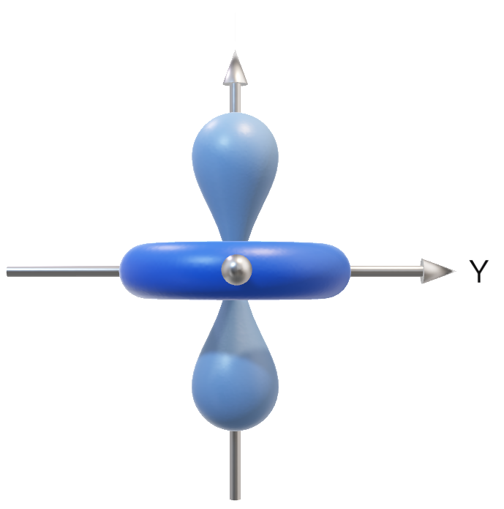
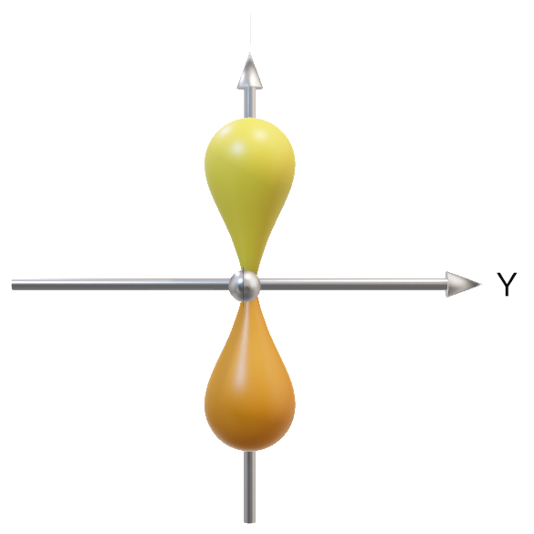
O_{3,pz}

Slide 28
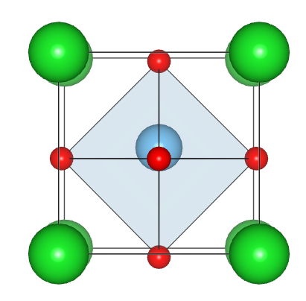






P$=$0, Tetragonal BTO
P$≠$0, Tetragonal BTO
d_{x}²_{-y}²
e_{g}
0.03 eV
d_{x}²_{-y}²
d_{z}²
0.023 eV
e_{g}
d_{z}²
$$≈$$
1.886 eV
1.909 eV
t_{2g}
d_{yz}, d_{zx}
$$≈$$
0.003 eV
d_{xy}
t_{2g}
0.05 eV
d_{xy}
0.003 eV
d_{yz}, d_{zx}
O₃
O₃
Ti
O₁
O₁
O₂
O₂
O
0.003 eV
O₁ p_{y},O₂ p_{x}
O₃ p_{z}
0.01 eV
0.01 eV
O₃ p_{z}
0.001 eV
O₁ p_{x},O₂ p_{y}
0.001 eV
0.005 eV
O₃ p_{x,y}
O₁,O₂ p_{z}
O₁ p_{y},O₂ p_{x}
0.001 eV
O₁ p_{x},O₂ p_{y}
0.025 eV
0.005 eV
O₁,O₂ p_{z}
O₃ p_{x,y}

Slide 29


Non-Centro G₀W₀ (8$×$8$×$8) vs. Centro G₀W₀ (8$×$8$×$8)

Slide 30





Finite Difference Time Domain simulation
Solving Maxwell’s equation and measure the loss in a waveguide system

Slide 31
Simulating mesoscopic scale physics in an actual device!

Slide 32




(a)
(b)
(c)
DW
(d)
With DW
Without DW

Slide 33
Phase Field Simulation – Thermodynamics
Using Landau-Ginzburg-Devonshire free energy, long-range interactions are in polynomials, short-range are in coefficients
Using finite element method, we can solve this on a realistic experimental geometry

Slide 34


Phase Field Simulation – Thermodynamics
None of the microscopic terms are considered, only the order parameters and temperature-dependent coefficients

Slide 35



Manybody Perturbation Theory

Slide 36



Manybody Perturbation Theory

